Slide 1


Learning Without Forgetting Approaches for Lifelong Robotic Vision
Zhengwei Wang ¹, Eoin Brophy ² and Tomás E. Ward ²
1. V-SENSE, School of Computer Science and Statistics, Trinity College Dublin.
2.. Insight Centre for Data Analytics, Dublin City University.

Slide 2
Introduction
Humans and animals have the capacity to continuously acquire, refine and transfer knowledge throughout their lifetime.
This process is known as Lifelong Learning.
Lifelong Learning is not easily transferred to Machine Learning and forms parts of Robotic Vision problems.

Slide 3
Motivation/Drivers
Main problem we are concerned with:
Catastrophic forgetting
Caused by:
The distribution of datasets amongst others
Can be improved through a few approaches.
Regularization
Dynamic Architectures
Complementary Learning Systems
Notes:
Are current approaches efficient? Can we reduce computational load on system?

Slide 4
Method
We chose Learning without Forgetting (LwF) strategy for this work.
Used pre-trained MobileNetV2, retain weights up to bottleneck layer as Өp.
Train bottleneck from scratch.
Retain Ө_{old} that is trained from previous tasks to construct regularization term for new weights Ө_{new}
Note:
No replay of previous task images. Only the updated weights Ө_{new} is retained after training -> to be used in testing.
Notes:
Chose LwF because of it’s advantages.. Low computational cost and Simplicity in deployment.
Weights up to the bottleneck are retained as Өp. Here Өp is fine tuned during training.
In order to introduce LwF we retain Өold

Slide 5
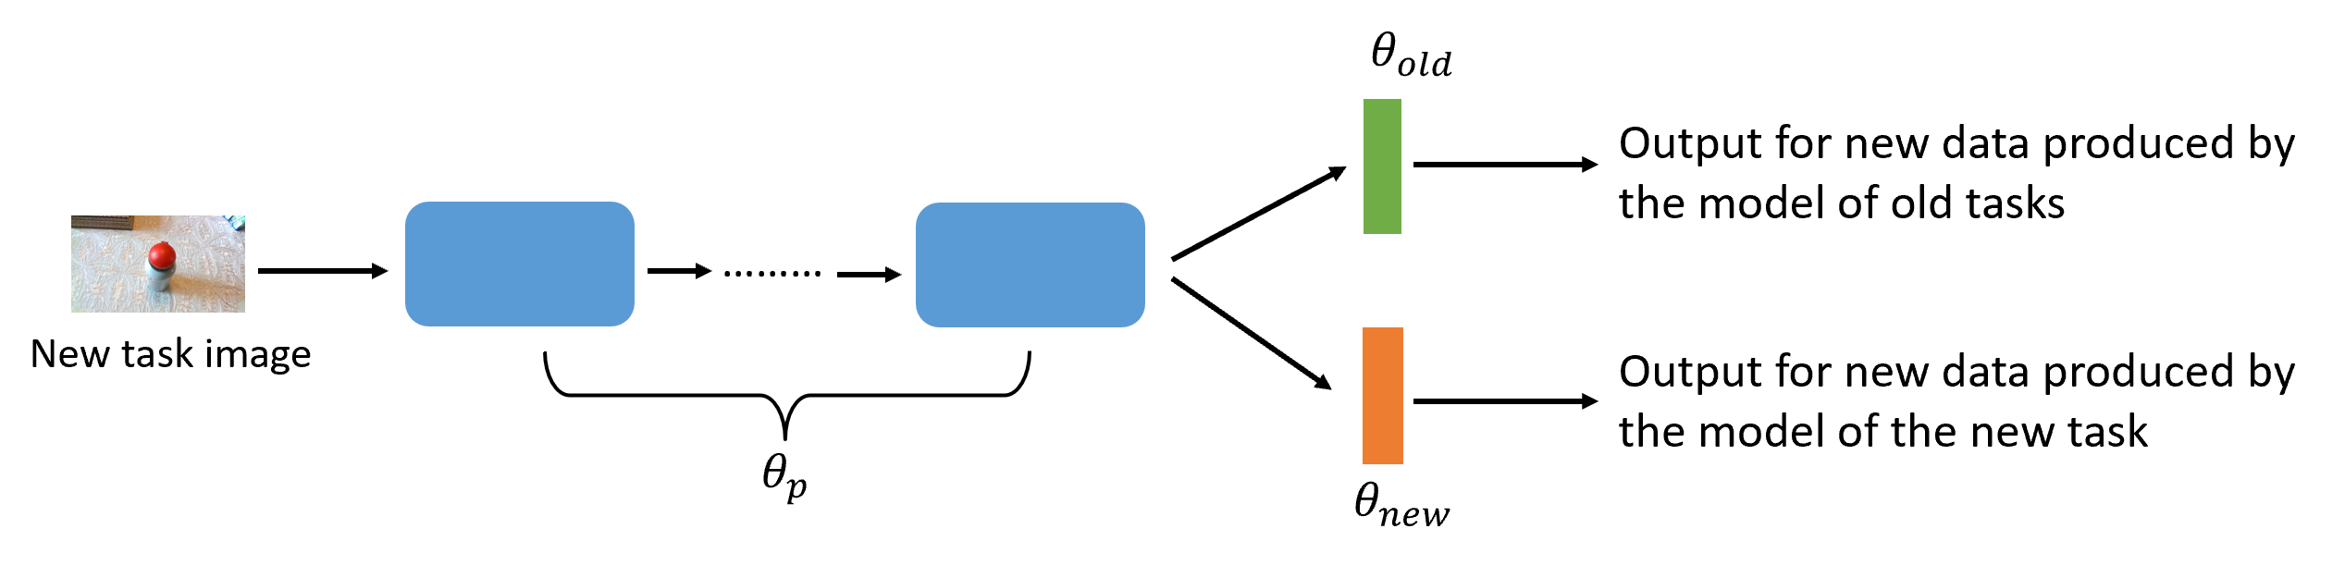
Method - Architecture

Slide 6
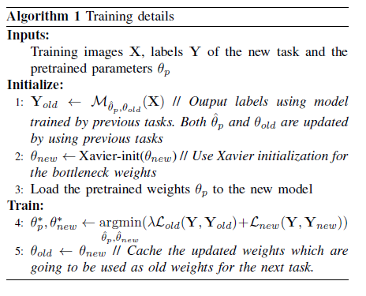
Method - Algorithm

Slide 7
Method
Did not retain old weights Өold for each task.
Instead of fine tuning Өp continuously for each task, we load pre-trained weights to Өp for each new task and fine tune
We find initializing Өp as pre-trained weights for each task performs better than using Өp continuously trained by all tasks.
Notes:
1. Yes this might deteriorate performance but it is closer to the ‘real-world’ scenario.

Slide 8
Results
Model | Accuracy
MLwF | 76.7%
M1 | 60.9%
M2 | 74.3%
Validation Accuracy of three models.
MLwF – Our Model with LwF strategy
M1 – no lifelong learning strategy
M2 - Fine tunes Өp continuously
Notes:
Our model outperforms the baseline model M1 which employs no lifelong learning strategy and M2 which fine tunes Op continuously

Slide 9
Conclusion
This approach applies Learning without forgetting to robotic vision tasks in a ‘real-world’ scenario.
The core backend is to prevent catastrophic forgetting.
We build on the original approaches in order to become more suitable to this challenge.

Slide 10



Thank you for listening
The team.
Zhengwei
Eoin
Tomás
Corresponding email: Zhengwei.wang@tcd.ie

